Slide 1
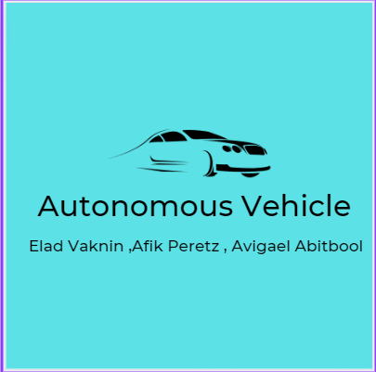






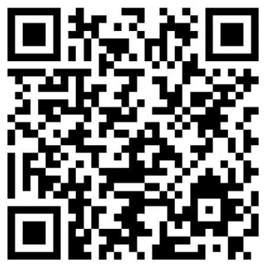
Autonomous Vehicle Elad Vaknin ,Afik Peretz, Avigael Abitbool Instructed by Professor Boaz Ben Moshe
31
Contribution/project goal: The project is designed to give a develop a solution for navigation in autonomous vehicles (in a simulator or a real car), with an emphasis on the reliability of the autonomous software.
2. Introduction :
3. Methods/algorithms/Alternatives or Design Considerations :
4. Selected Approach :
5. Solution Description :
Visit Us

